Slide 1



Slide 2


Project Name : ZOMATO ANALYTICS
Mentor: Dhanshri Project Members :
Dipti Usha Chandrakant Khaire Mr. Samrat jha
Mr. Vinith Krishna Sai Dasam Mr. Ashish Rajitram Nishad
PRIYODARSHINI HAZARIKA

Slide 3







AGENDA :
DATA SET
KPIS
INTRODUCTION AND PROBLEM STATMENT
DASHBOARD
BUSSINESS OBJECTIVE
CONCLUSION

Slide 4
DATA SET USED FOR THE PROJECT

Slide 5
Introduction: This Zomato Analytics Project aims to leverage this rich dataset to extract actionable insights that can drive business decisions, enhance customer experience, and optimize restaurant operations. The project analyzes key aspects of Zomato’s platform, including user behavior, restaurant popularity, pricing trends, ratings, and geographic distribution. By applying data analytics techniques such as data cleaning, and visualization.
Problem Statement:
Zomato Analytics
Convert the Average cost for the 2 columns into USD dollars.
Find the Numbers of Resturants based on City and Country.
Count of Resturants based on Average Ratings
Create buckets based on Average Price of reasonable size and find out how many resturants falls in each buckets
Percentage of Resturants based on "Has_Table_booking
Percentage of Resturants based on "Has_Online_delivery"
Develop Charts based on Cusines, City, Ratings ( Candidate have to think about new KPI to analyse)

Slide 6
Business Objective:
The primary objective of this Zomato Analytics project is to leverage data to enhance decision-making for both Zomato and its restaurant partners. By analyzing customer preferences, restaurant performance, and market trends, the goal is to:-
Identify factors influencing restaurant ratings and user engagement.
Understand geographic and demographic trends in food preferences.
Recommend strategies for pricing, promotion, and restaurant placement.
Optimize customer satisfaction and retention through data-driven insights.
Support strategic planning for Zomato’s market expansion and partner onboarding.

Slide 7
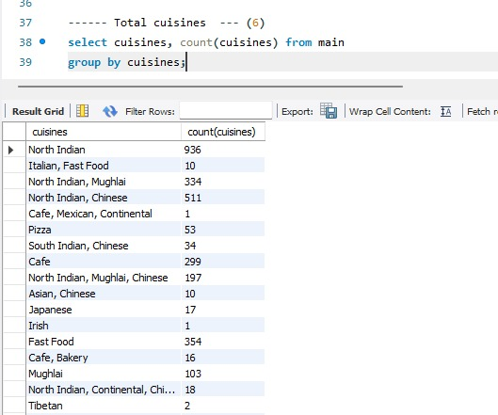
KPI 1 Total cuisines.

Slide 8
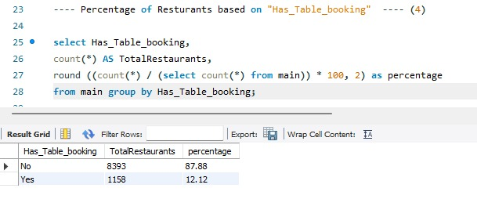
KPI 2
Percentage of Restaurants.

Slide 9
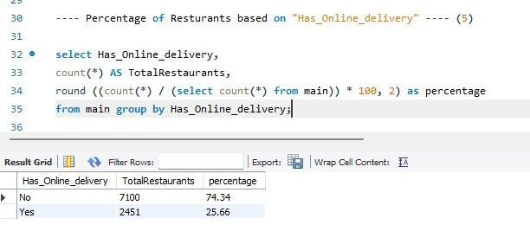
KPI 3
Percentage of Restaurants based on Has_online_delivery.

Slide 10
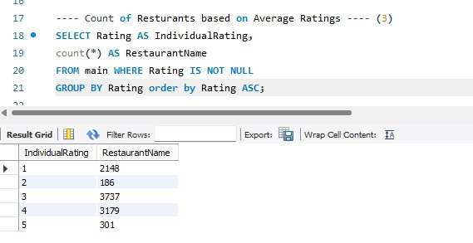
KPI 4
Count of Restaurants based on Average Ratings.

Slide 11
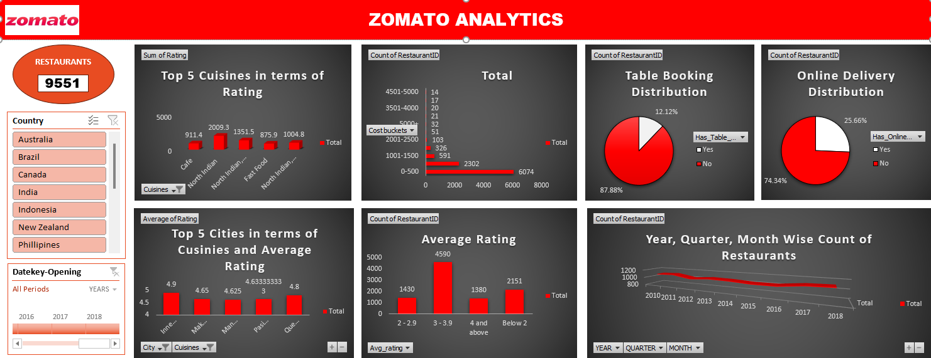
EXCEL DASHBOARD

Slide 12
FILE CONNECTIONS IN TABLEAU

Slide 13
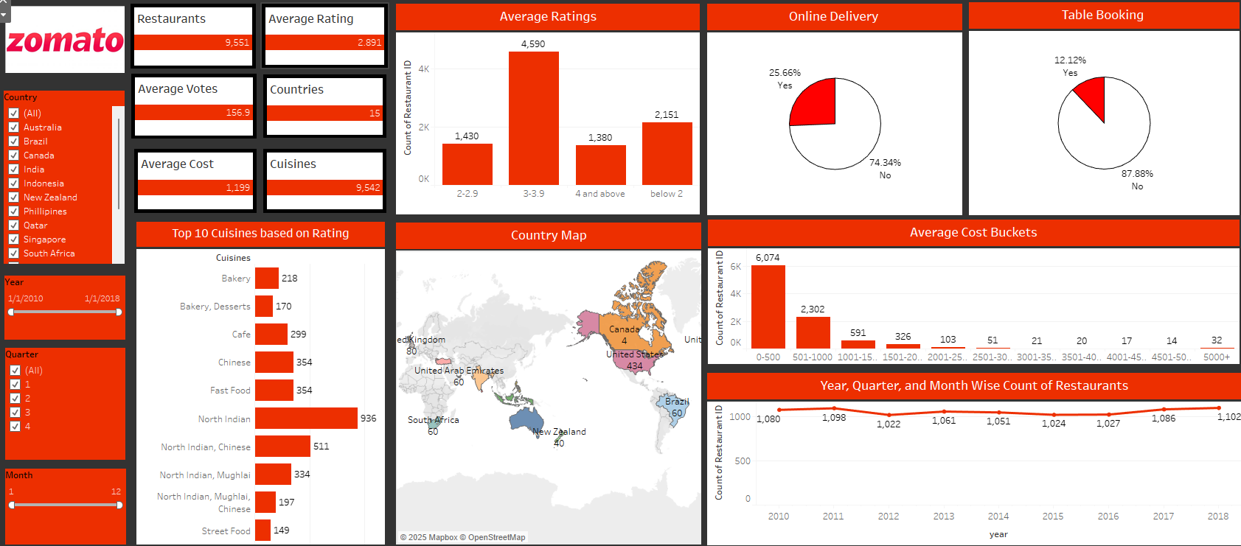
TABLEAU DASHBOARD

Slide 14
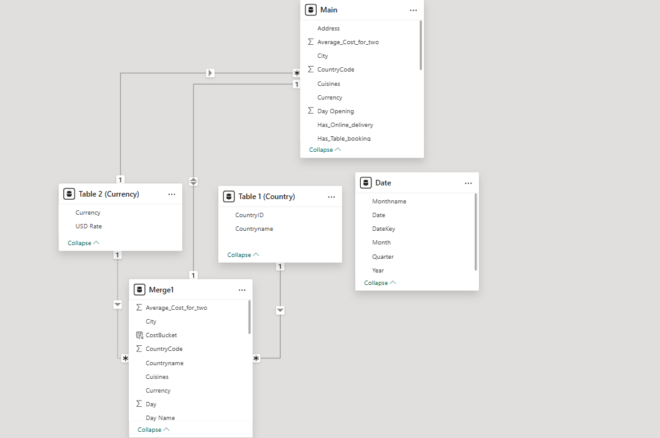
FILE CONNECTIONS IN POWER BI

Slide 15
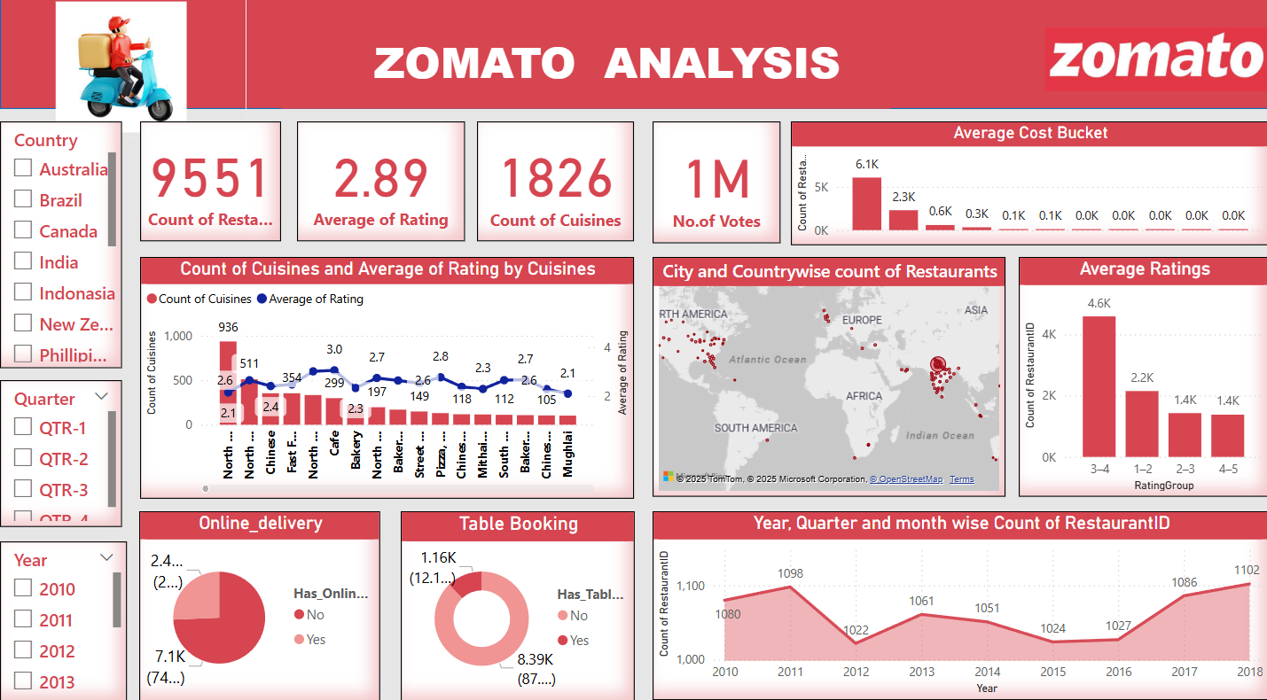
POWER BI DASHBOARD

Slide 16

Conclusion :
The Zomato Analytics Project leveraged Excel, Power BI, Tableau, and SQL to analyze KPIs, enabling data-driven decision-making.
The Zomato Analytics project provided valuable insights into customer behavior, restaurant performance, and market dynamics within the food delivery ecosystem.
Through detailed data analysis and visualization, we identified key factors that influence user rating, restaurant popularity, and pricing strategies.
Key finding revealed that location, cuisine type, cost for two, and user ratings significantly affect a restaurant’s success on the platform.
Additionally, areas with a high density of popular restaurants often reflect customers’ preferences and higher engagement levels.
These insights can help Zomato and its partner restaurants make data-driven decisions to improve service, enhance customer satisfaction, and boost business performance.

Slide 17


